Slide 1
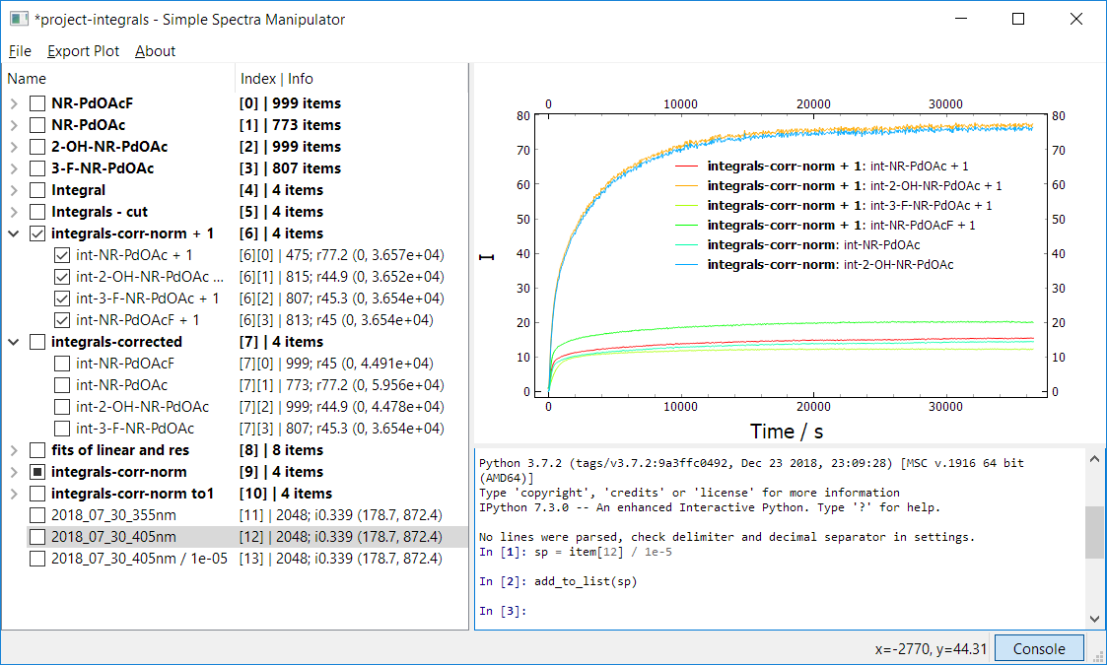
Overview
Index | number of items in group
Index | number of data points; spacing (x_{min}, x_{max})
spacing (x difference among points):
r – probably regular spacing among all datapoints
i – probably irregular spacing among all datapoints
value calculated as average for all datapoints
x range (x_{min}, x_{max}) written with 4 significant figures
Group Item (bold text)
Tree Widget
Plot Widget
running on PyQtGraph (modified)
http://www.pyqtgraph.org/
Spectrum Item
Console
IPython console running
runs on qtconsole
https://ipython.org/ipython-doc/3/interactive/qtconsole.html
Status bar
Cursor coordinates in Plot Widget

Slide 2
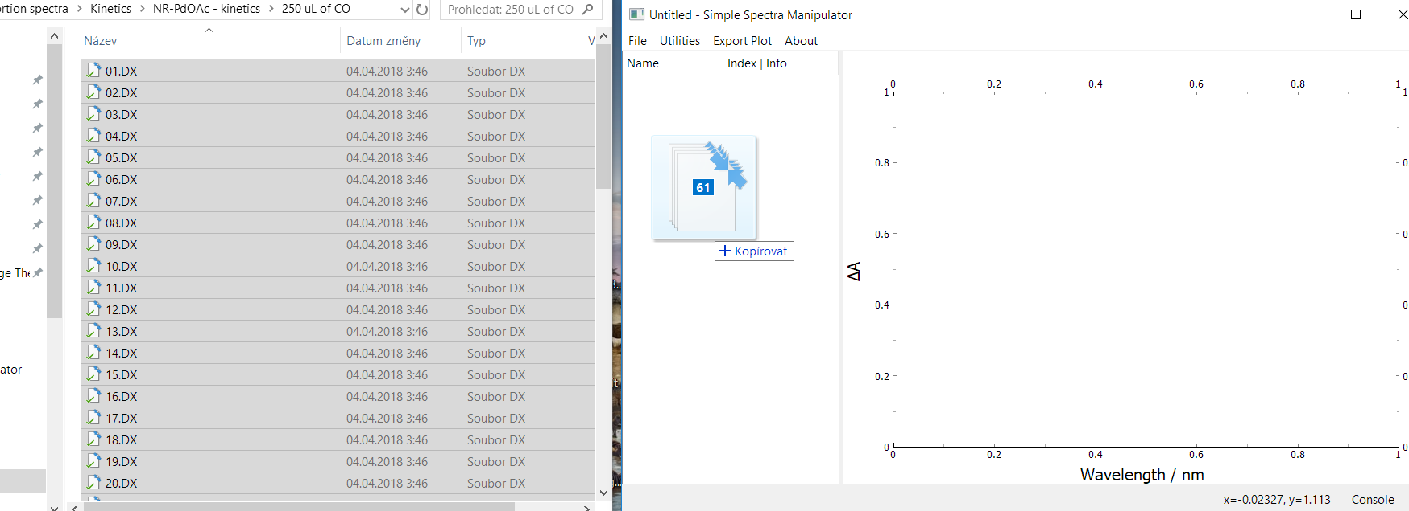
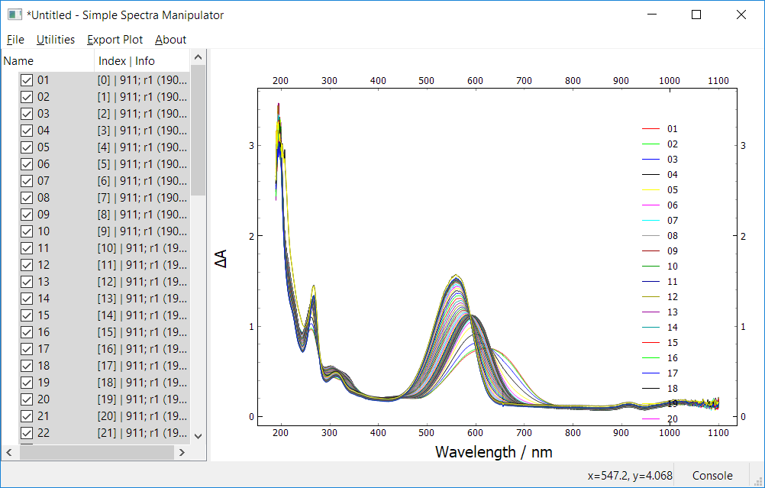
Importing files and Plot Widget interaction
To import some Spectra, just drag the files from file exporer and drop them in the Tree Widget window (you can also from File->Import Files), then to select all of the imported spectra, press Ctrl + A and then Ctrl + Q which is the shortcut for checking the selected spectra. And so on.... The program is intuitive I hope...
Ctrl+A,
Ctrl+Q
Some DX files contains also errors, in this way, the two items will be imported for one DX file, you can get rid of the errors by deleting these items only (use select every n-th item function – vide infra)
To put spectra in group, just select the spectra you want to put in the group and right click on the selection and choose Add Items To Group
Saving to project is made by the same way as in other programs, Ctrl + S for Save or Ctrl + Shift + S for Save As, the extension for project files is .smpj, you can load the project from the File->Open project or just drag-drop the smpj file to Tree Widget window like for spectra
Plot Widget interaction
Strongly prefer to use default mouse mode (3 button mode, you will get use to it), that is, the scaling is done by right mouse button dragging, left mouse button dragging pans the scene, zooming by mouse wheel as usual
If you loose the image, just right click in the Plot Widget and click View All
For more information, see the pyqtgraph documentation
http://pyqtgraph.org/documentation/mouse_interaction.html

Slide 3
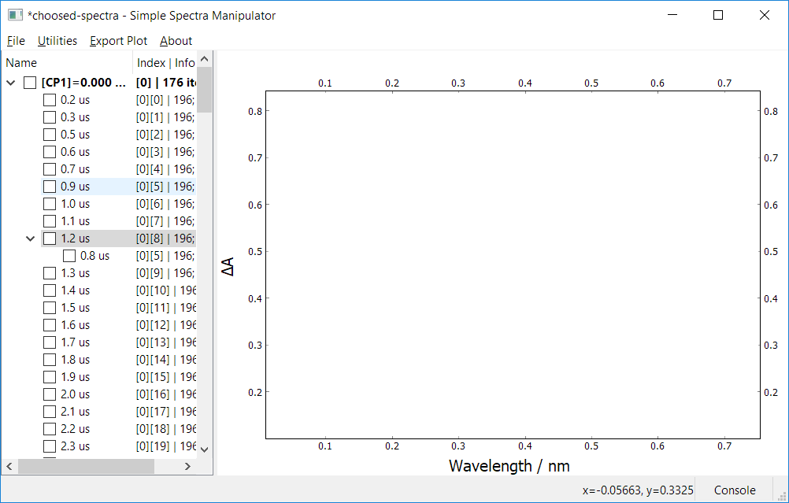
Mooving and copying the items/groups
You can freely move the individual and multiple in the Tree Widget, as well as groups of spectra. For moving, just use left mouse button dragging. The copying withing the list works the same, but you have to hold Ctrl when releasing the items in the desired location. The interaction is fast for small number of items, but for large lists, >1000 items, it became slower. This is a bug in PyQt/Qt package and I cannot do anything about that...
The list is designed that it can only have 2 levels (spectra in group cannot have children). But, during some fast manipulation, the similar situation that is shown below can happen:
If that happen, you have to manually move it to the grandparent or root node, otherwise, the program will crash sooner or later during some operations, its just a bug that can happen a you have to count with that
You can also open another SSM program and move the items/groups between different program instances, in this way, the data are always copied regardless of holidng Ctrl or not

Slide 4
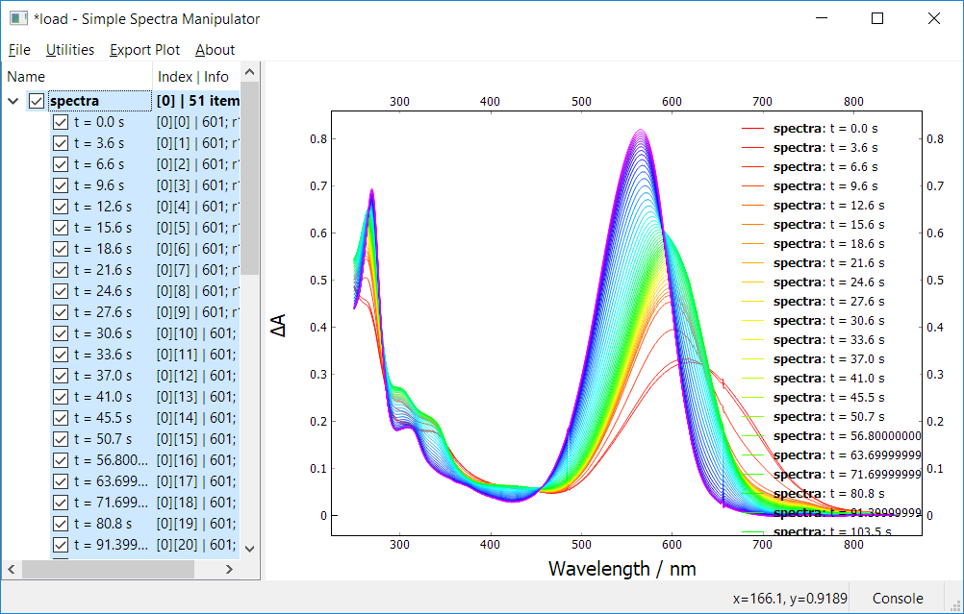
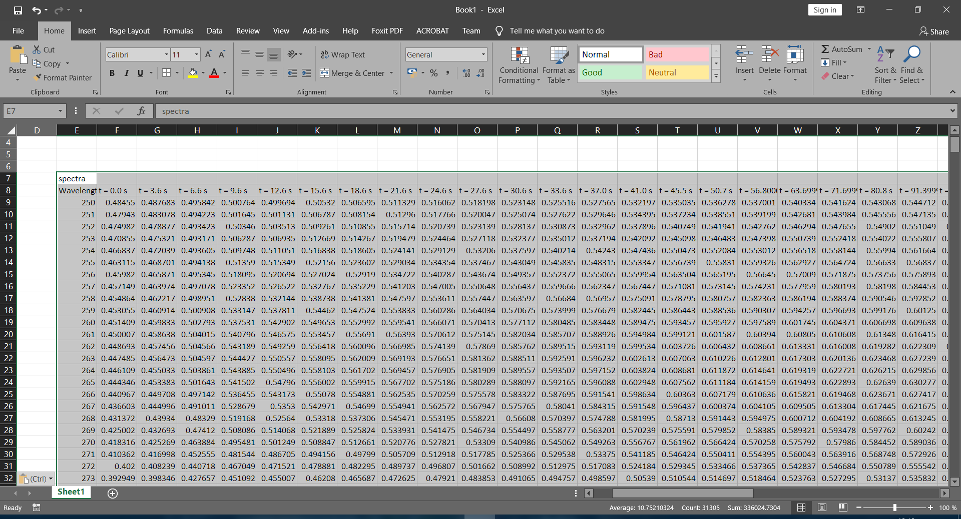
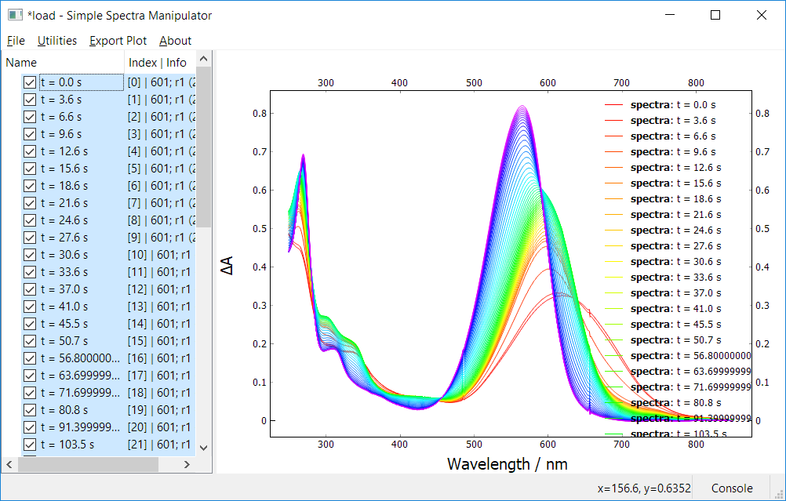
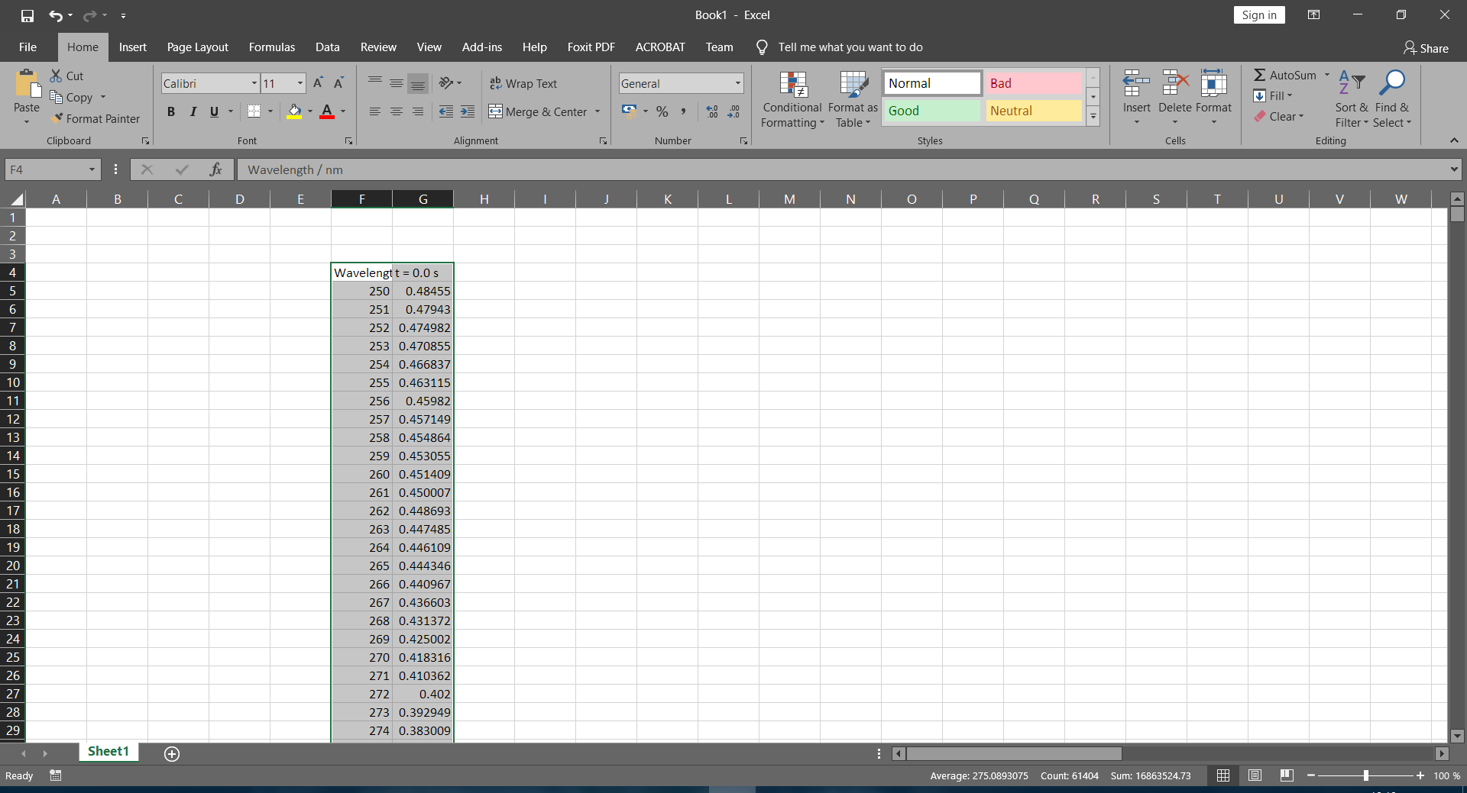
Copying to Excel/Origin
To copy the spectra, just select the spectra you would like to copy and press Ctrl+C. The results are shown below. If the spectra are in group, they will be concatenated (this is usually what we want). In this case, all spectra in the group must have the same number of points and same x range, otherwise, error will be raised. If the spectra are placed in the root (top level items), they will be stuck to one another (only first spectrum seen in Excel). Please, look at Setting Export tab, to change appropriate settings. If you want to retain this compatibility, the delimiter in Clipboard has to be tabulator \t. Only with this settings, we can easily transfer data to Excel/Origin by Windows Clipboard. You can also import data from clipboard to the program and also from Excel. Check Settings Import Tab: Clipboard for more info.
Ctrl+C
Ctrl+V
Ctrl+C
Ctrl+V

Slide 5
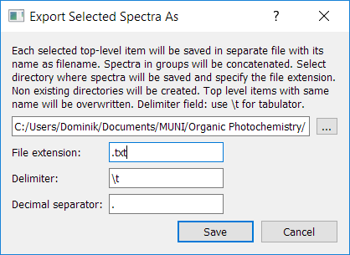
Exporting spectra to files
The exporting of spectra to files works the same way as with copying. Spectra in group will be concatenated. Spectra in root (top level items) will be saved as individual files. Just select the root items you want to export as files and go to File->Export Selected Spectra As and this dialog below should appear:
files are saved with utf-8 encoding
Just select the directory where you want your spectra to be saved and set the file extension (you can omit the dot, so eg. just write ‘txt’ or ‘csv’), delimiter which is the characted that separates the columns and decimal separator, then click Save
The name of the file is determined by the name of the top level item (if the top level item has no name, ‘Untitled’ with index is used as name)
Files with the same name in the saved directory will be overwritten without notification, beware ot that
For header options, look at settings Export tab

Slide 6
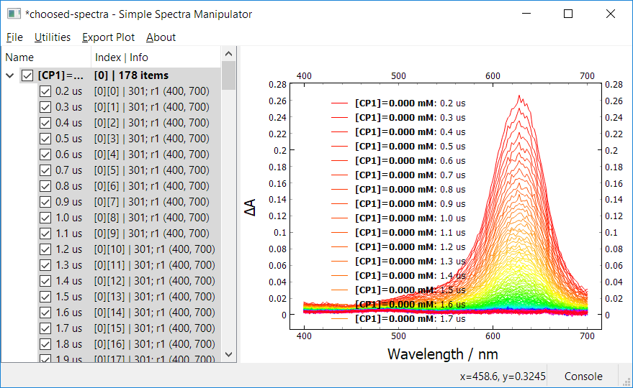
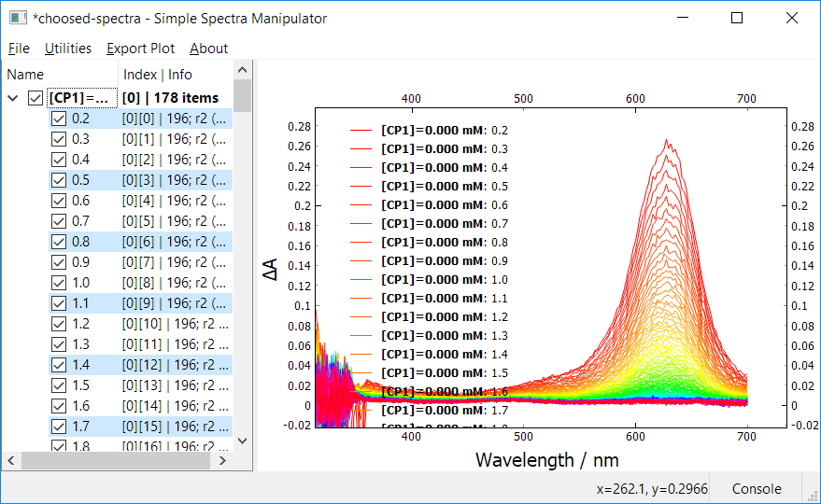
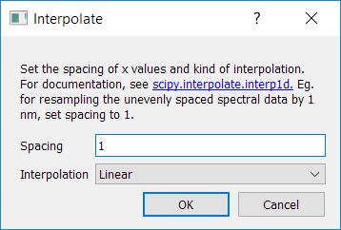
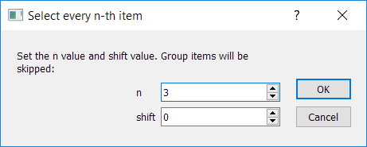
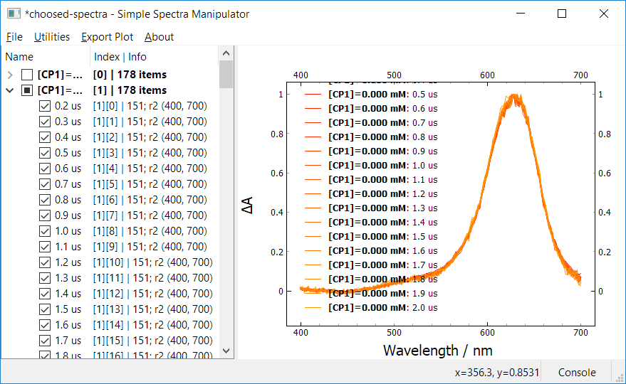
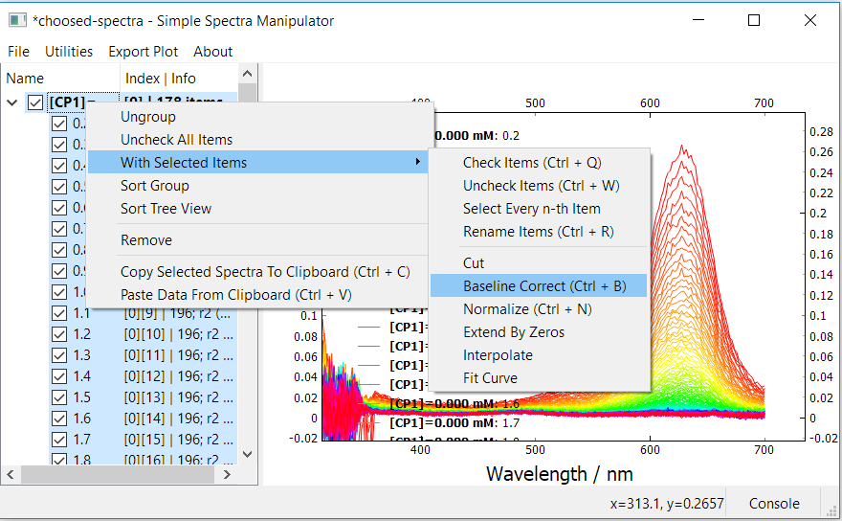
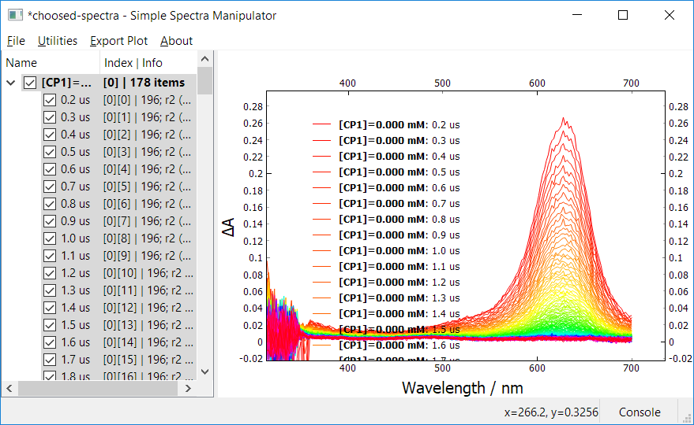
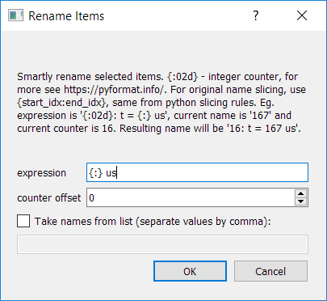
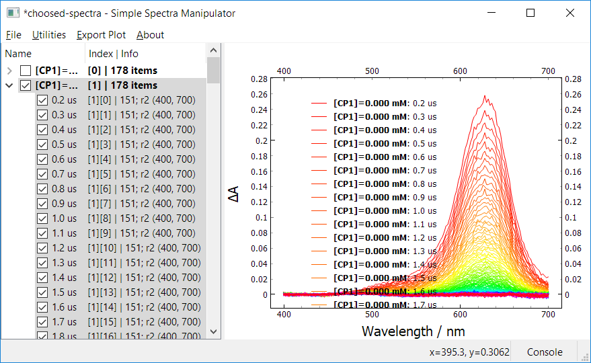
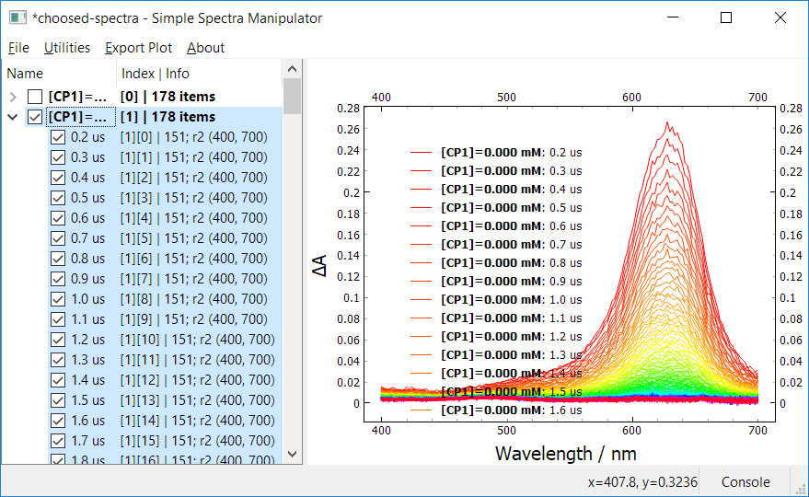
Operations Overview
Select Every n-th Item
the number of points doubled from 151 to 301 and spacing is changed from ‘r2’ to ‘r1’, the shape of spectra is unchanged, because we upsampled by linear interpolation (increased the number of points)
Interpolate
n=3, shift=0
used for example to change irregular spacing to regular
here - change the spacing from 2 nm to 1 nm
Rename
Items
added ‘ us’ after each spectrum name
Normalize
plotted only up to 2 us
Cut to 400 - 700 nm
Baseline correct
Extend by zeros only extends the spectra by zeros for selected x range, while keeping the spacing the same as original spectrum
this should not be done for transient spectra this way, here just for demonstration purposes (subtracted average from 410-470 nm)

Slide 7
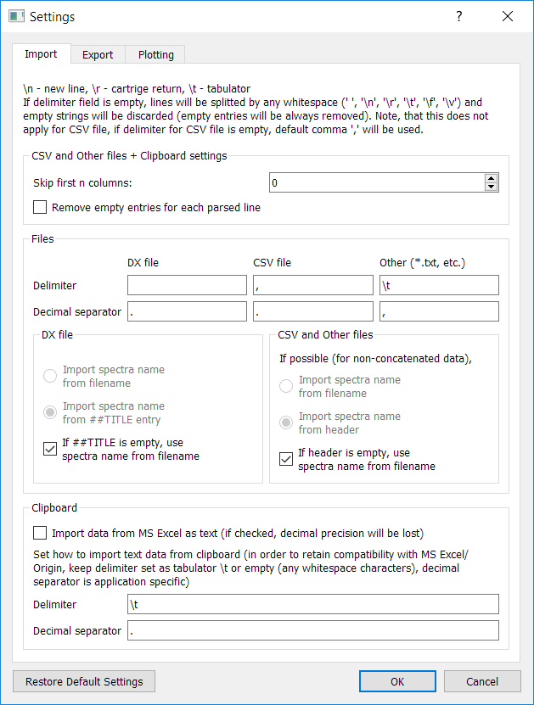
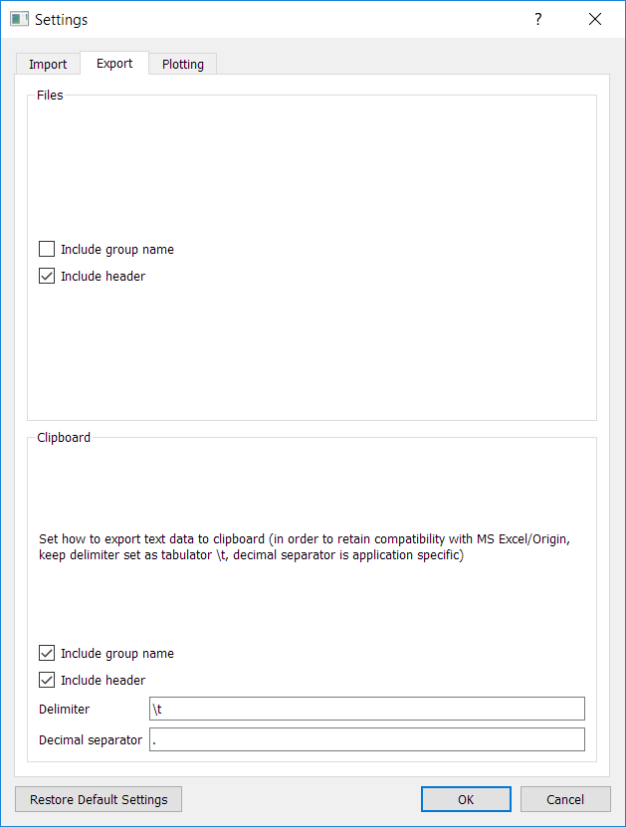
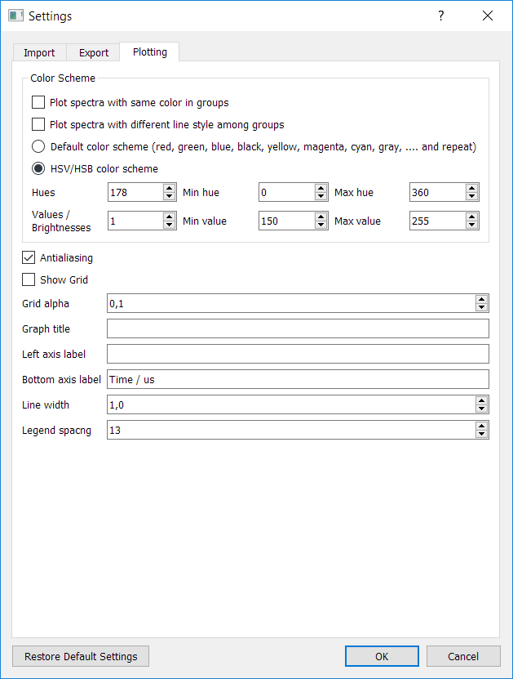
Settings
most important part, sets how to import files (sets the line delimiter and decimal separator) for different kind of files, for files, that has for example empty entries (only delimiter eg. two commas) at the beginning of the file, sets the number of columns that will be skipped, or there is an option that will remove all empty entries from each line, please, consider these options based on the file you are trying to import
the CSV file is parsed using the csv module for python
delimiter for dx file is space - “ “ (not visible)
columns that will contain at least one NAN (not a number) value will be excluded
Settings for Plot Widget
useful settings
line delimiter, decimal separator and file extension in file export dialog
Header import settings
keep at <= 1.0, interaction with graph for values > 1 will be slower
When copying data from Excel, Excel saves data into clipboard in many formats, text and XML raw data format among others. Data in text are saved as they are seen in Excel (when rounding is on, values may be saved without full decimal precision). To import data copied from Excel with full decimal precision, raw Excel XML data has to be parsed. Therefore, for full decimal precision, keep this checkbox unchecked.

Slide 8
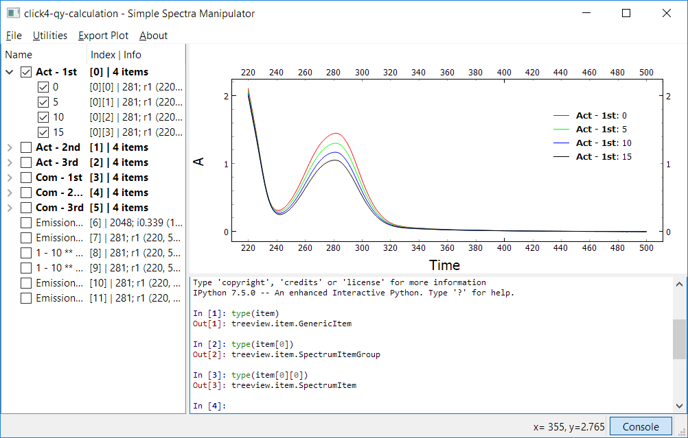
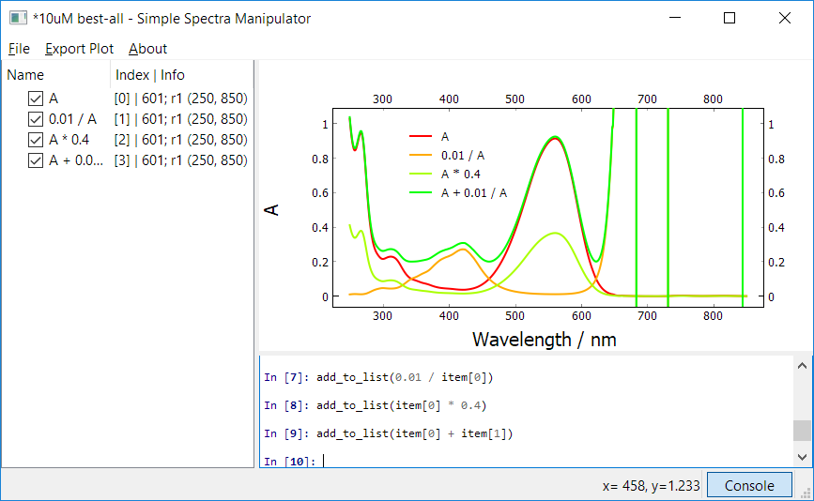
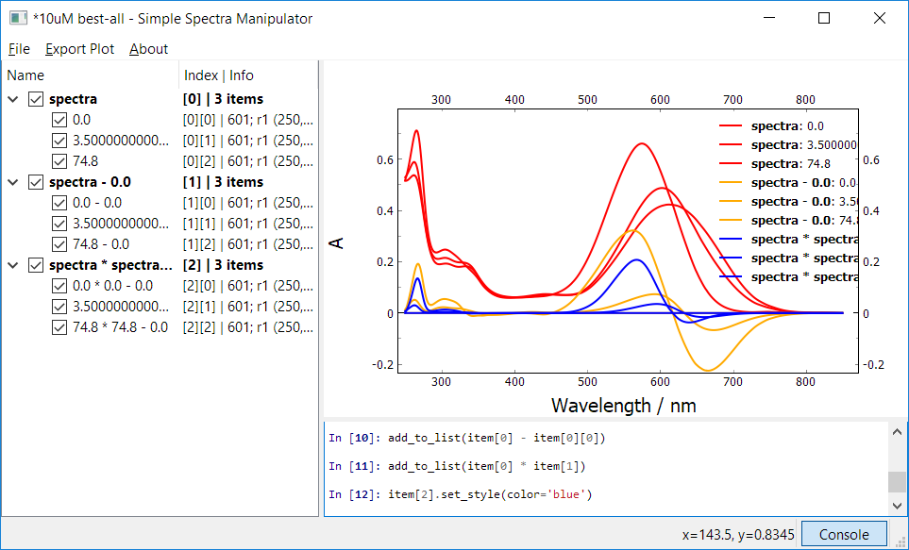
Console and simple computations
The main reason for having a console in the program is to provide interface to fast arithmetic operations with spectra items and all groups of items and show program messages and reports. Regular IPython console is running in the window (qtconsole widget – lot of thanks to programmers for this package), so also for a low level interaction with the running program (for experienced users, see documentation).
When performing arithmetic operation between Spectrum – Spectrum, the number of points and same x range (start and end value) of both spectra have to be the same, otherwise, error is raised
The most important is variable item, which is internally a root item in Tree Widget and provides an access to all members. Just write item and then in square bracket rewrite the index, that is in the info column for each Item/Group. When performing any arithmetic operation (addition, subtraction, multiplication, division, negation, power) among number/spectrum/group, the new Spectrum or SpectrumList object is always returned as a result of computation. So, nothing is happening with the original data. The y values are used in calculations. To add the result to the Tree Widget, you have to call function add_to_list(result) which takes result of computation as an argument. Examples are given below:
SpectrumItemGroup inherits from SpectrumList,
so it shares the same methods with SpectrumList
SpectrumItem inherits from Spectrum,
so it shares the same methods with Spectrum
number – spectrum
spectrum – number
group – spectrum
spectrum – spectrum
group – group
The main power of the Console comes with the use of defined functions in classes Spectrum / SpectrumList (see documentation) like integration, differentiation, savitsky-golay filter, fourier transform and others for the groups of spectra. It is a time and life saver, because doing this work in Excel/Origin would take forever.

Slide 9
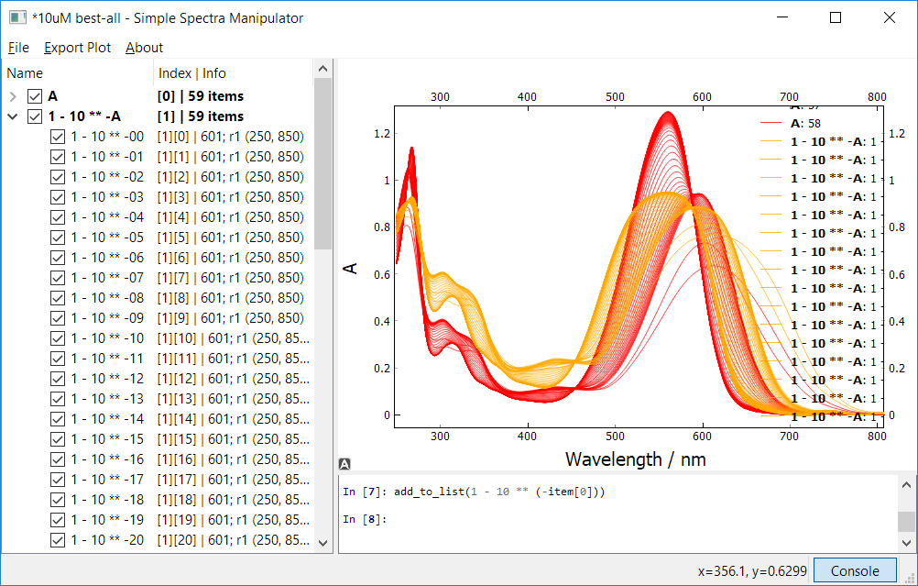
Console and simple computations
More complicated transformations, eg. $1−{10}^{−A}$(fraction of absorbed light), can be performed as easily as simple ones. ** is operator for power in Python. Here, the degree of abstraction is pretty significant. We are performing operation on a group of spectra. The operation $1−{10}^{−A}$ is performed for every y value of each spectrum in the group, in total 601 * 59 calculations (actually many more, because this operation is splitted internally into 3 separate operations – negation, then power and lastly subtraction). In Excel, we would have to make a matrix of 601 x 59 absorbances and then perform operation on each cell.
this is for autoscale, by clicking this, the autoscale will be ON till you manually change the scale or pan the plot

Slide 10
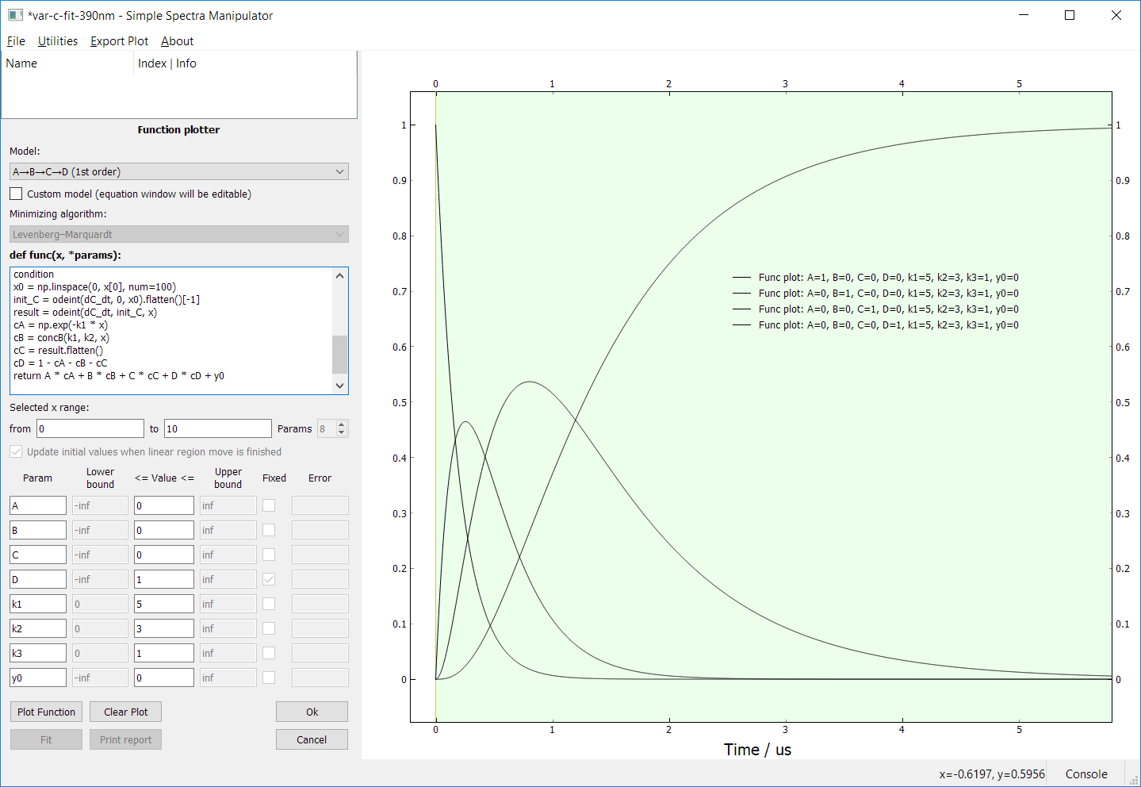
Function plotter
By going to Utilities in Menu bar a clicking on the Function plotter, the widget on the left side should appear. This widget is designed for fitting, but can be used also for plotting custom or predefined models. Just select a model, adjust the x range by manipulating the linear region selector in graph or in the widget will be saved as items by changing the values and pressing Tab or Enter to update the plot. Then fill the parameter values and click Plot Function. You can change parameters many times and see how it looks. Then click OK and all plotted functions will be saved in the Tree Widget. The example below is plot for each component in ABCD 1st oder model.
The analytical solution for ABCD model is too complicated, therefore, the result is calculated by numerical integration of differential equations (only for component C with function odeint from scipy module)
Linear region selector
Equation window
Change parameters A, B, C, D to modifiy mixing of the components
Parameters

Slide 11
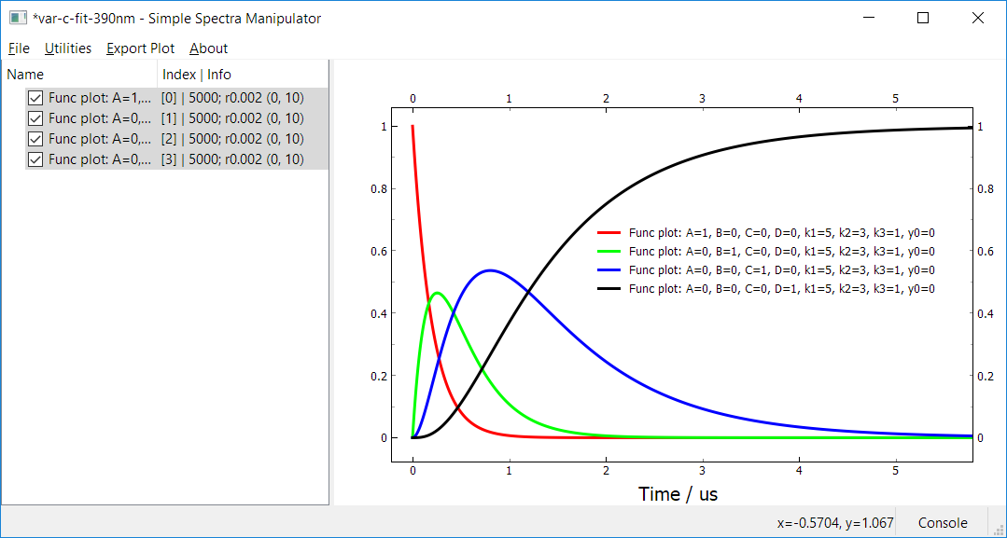
Function plotter and Export of the plot
After clicking OK, these plots will appear in the Tree Widget. The number of plotted points is set up to 5000, you can change this number in config.json file under the „FP_num_of_points” variable (or to change the default value, change FP_num_of_points variable in settings.py). Then, some beautiful color scheme is selected in settings along with the line width and the result is the plot below. The red curve corresponds to concentration profile of component A, the green one to component B, blue to component C and finally black curve to component D. The plot then can be copied to clipboard as image in Export Plot-> Copy As Image or as vector format SVG with Export Plot-> Copy As SVG. To be able to paste the vector SVG format to PowerPoint, one trick has to be made, because direct paste to PowerPoint sometime leads to cropped image. So, you have to first paste it in some free vector editing program (eg. Inkscape) and then re-copy from it and then paste to PowerPoint. Now, It will work.

Slide 12
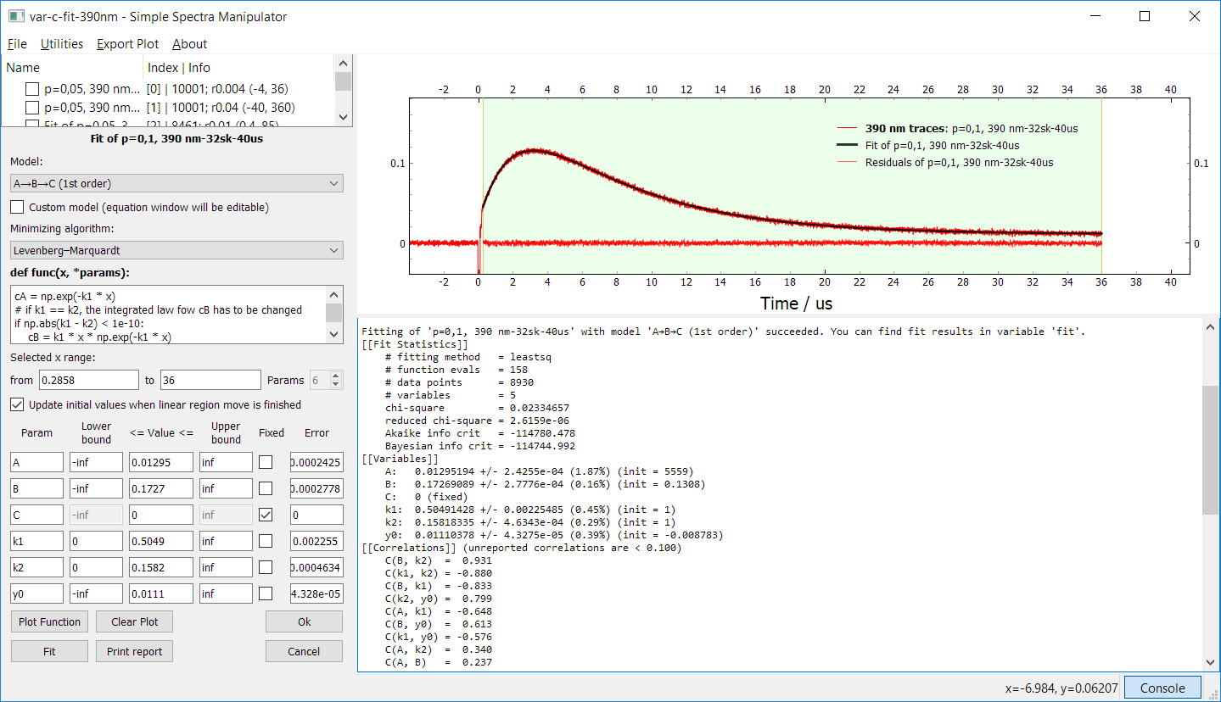
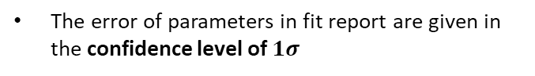
Fit curve
By right clicking on the spectrum (works only for 1 spectrum) and choosing from the menu: With Selected Items -> Curve Fit, the Fit widget will show. There you can choose from many predefined kinetic models. Each model encompasses all possible intermediates, so for example A->B->C model has parameters A, B, C which are the maximum absorbances (magnitudes) of that species. To make any component not visible (not in the system), just fix the value of this component to zero. Below is an example of fitting with such a model, with A and B components visible, but C not. Also, you can choose from many minimizing algorithms, most known and used is Lavenberg-Marquardt (LM), but also others, like Trust region reflective method or algorithms for scalar functions minimization (does not provide error), eg. Nelder-Mead Simplex method, which is slower, but more robust and tends to find global minimum in parameter space. LM algorithm is prone to stay in local minima, so, for fitting complicated models, it can be better to first find global minimum by Nelder-Mead and the switch to LM to calculate errors. Of course, sometimes, we want to stuck in local minima, because the parameters obtained from global better fit would not make any sense. The parameter boundaries can be limited by setting up lower and upper bounds. Also, the fitting result depends on initial parameters (noticeable for more complicated models).
Linear region selector
Fit widget
Equation window
for quick fitting of own function, check custom model checkbox and edit the python code (np – numpy) and parameter names
for future and multiple usage of own model, define new model in userfitmodels.py (make new class that inherits from _Model: just uncomment the example and change it, modify func, init_params and initialize_values (optional) methods and change the static name variable), parameter order in func (after x) must be in the order of added paramaters in init_params function
The error of parameters in fit report are given in the confidence level of $1σ$
Fit report by lmfit
https://lmfit.github.io/lmfit-py/fitting.html
Parameters
By pressing OK, the fit report is printed to the console and fit and residual spectra are added to the Tree Widget

Slide 13
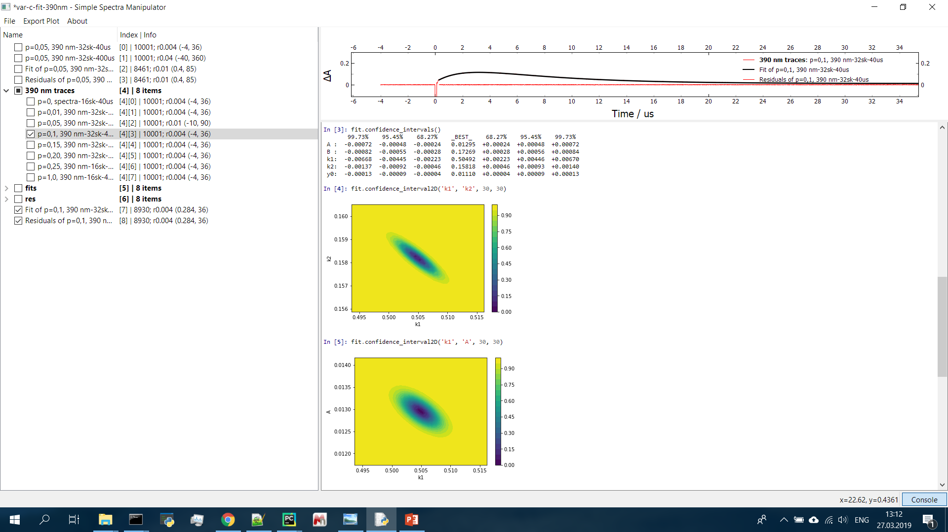
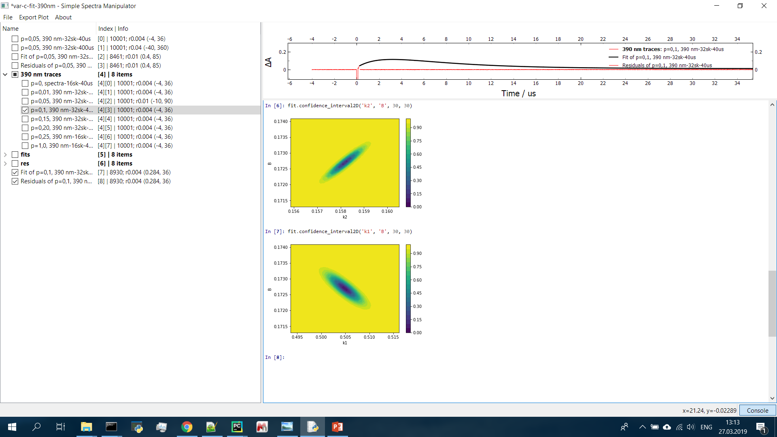
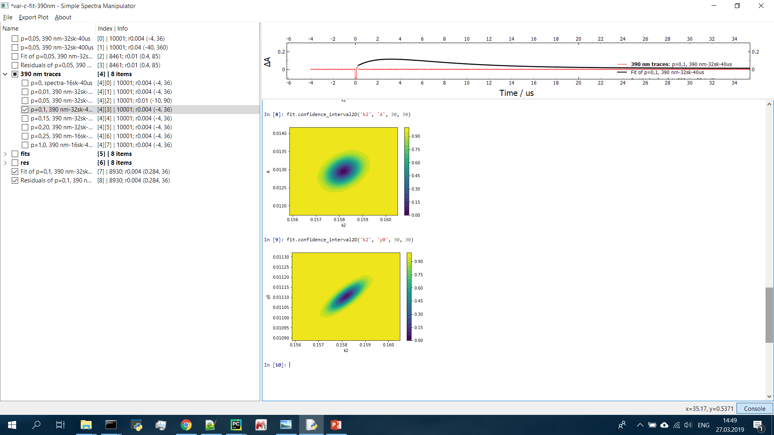
Fit results and confidence intervals
see https://lmfit.github.io/lmfit-py/confidence.html
The error of parameters in fit report are given in the confidence level of $1σ$. That is 68.27% probability that the value lies in the interval $(\overline{x}−σ, \overline{x}+σ)$, where $\overline{x}$is the average value. Errors are calculated from the covariance matrix. For modern and correct estimation of confidence intervals, we can use the functions in lmfit package (https://lmfit.github.io/lmfit-py/confidence.html). Read for more information, but in sumary, in some models (eg. sum of exponentials), estimation of parameter errors from covariance matrix could be wrong. Lmfit package provides function to calculate confidence intervals for these parameters correctly. Also, 2D confidence plot for two parameters is possible. The calculation takes some time, because the parameters are varied and others reoptimized by fitting. This can be really computationally demanding for complicated models.
variable fit is pushed to the console after fitting and is of type FitResult (API documentation). This variable has some members, the most important is values_errors, which stores values and errors of fitted parameters as ndarray. Data can be saved to clipboard by typing to the console this command: copy_to_clipboard(fit.values_errors)and then passed to Excel for example. First column contain params values, the second corresponding errors.
also, one can call confidence_intervals(), which calculates confidence intervals in a correct way, in the example below, which was the A->B->C model fit, confidence intervals for 3 sigmas (default) are given for all parameters
parameters are symmetrical of both sides, therefore, the analysis would not be necessary, errors from fit report are correct, but for some other models, this could not be the case
correct confidence intervals for 1, 2 and 3 sigmas
correlation between parameters can be also plotted by calling confidence_interval2D() function, see API documentation for parameter descriptions
we can see elipses, which is correct, but for other models, which does not behave normally, other shapes can be observes, also, if too complicated model is chosen, more minima can be observed
added after fitting

Slide 14
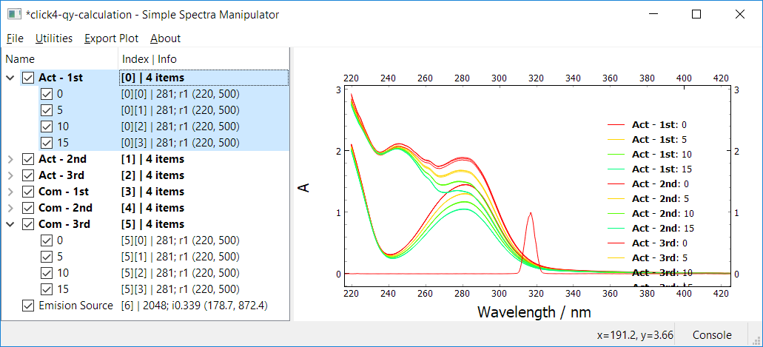
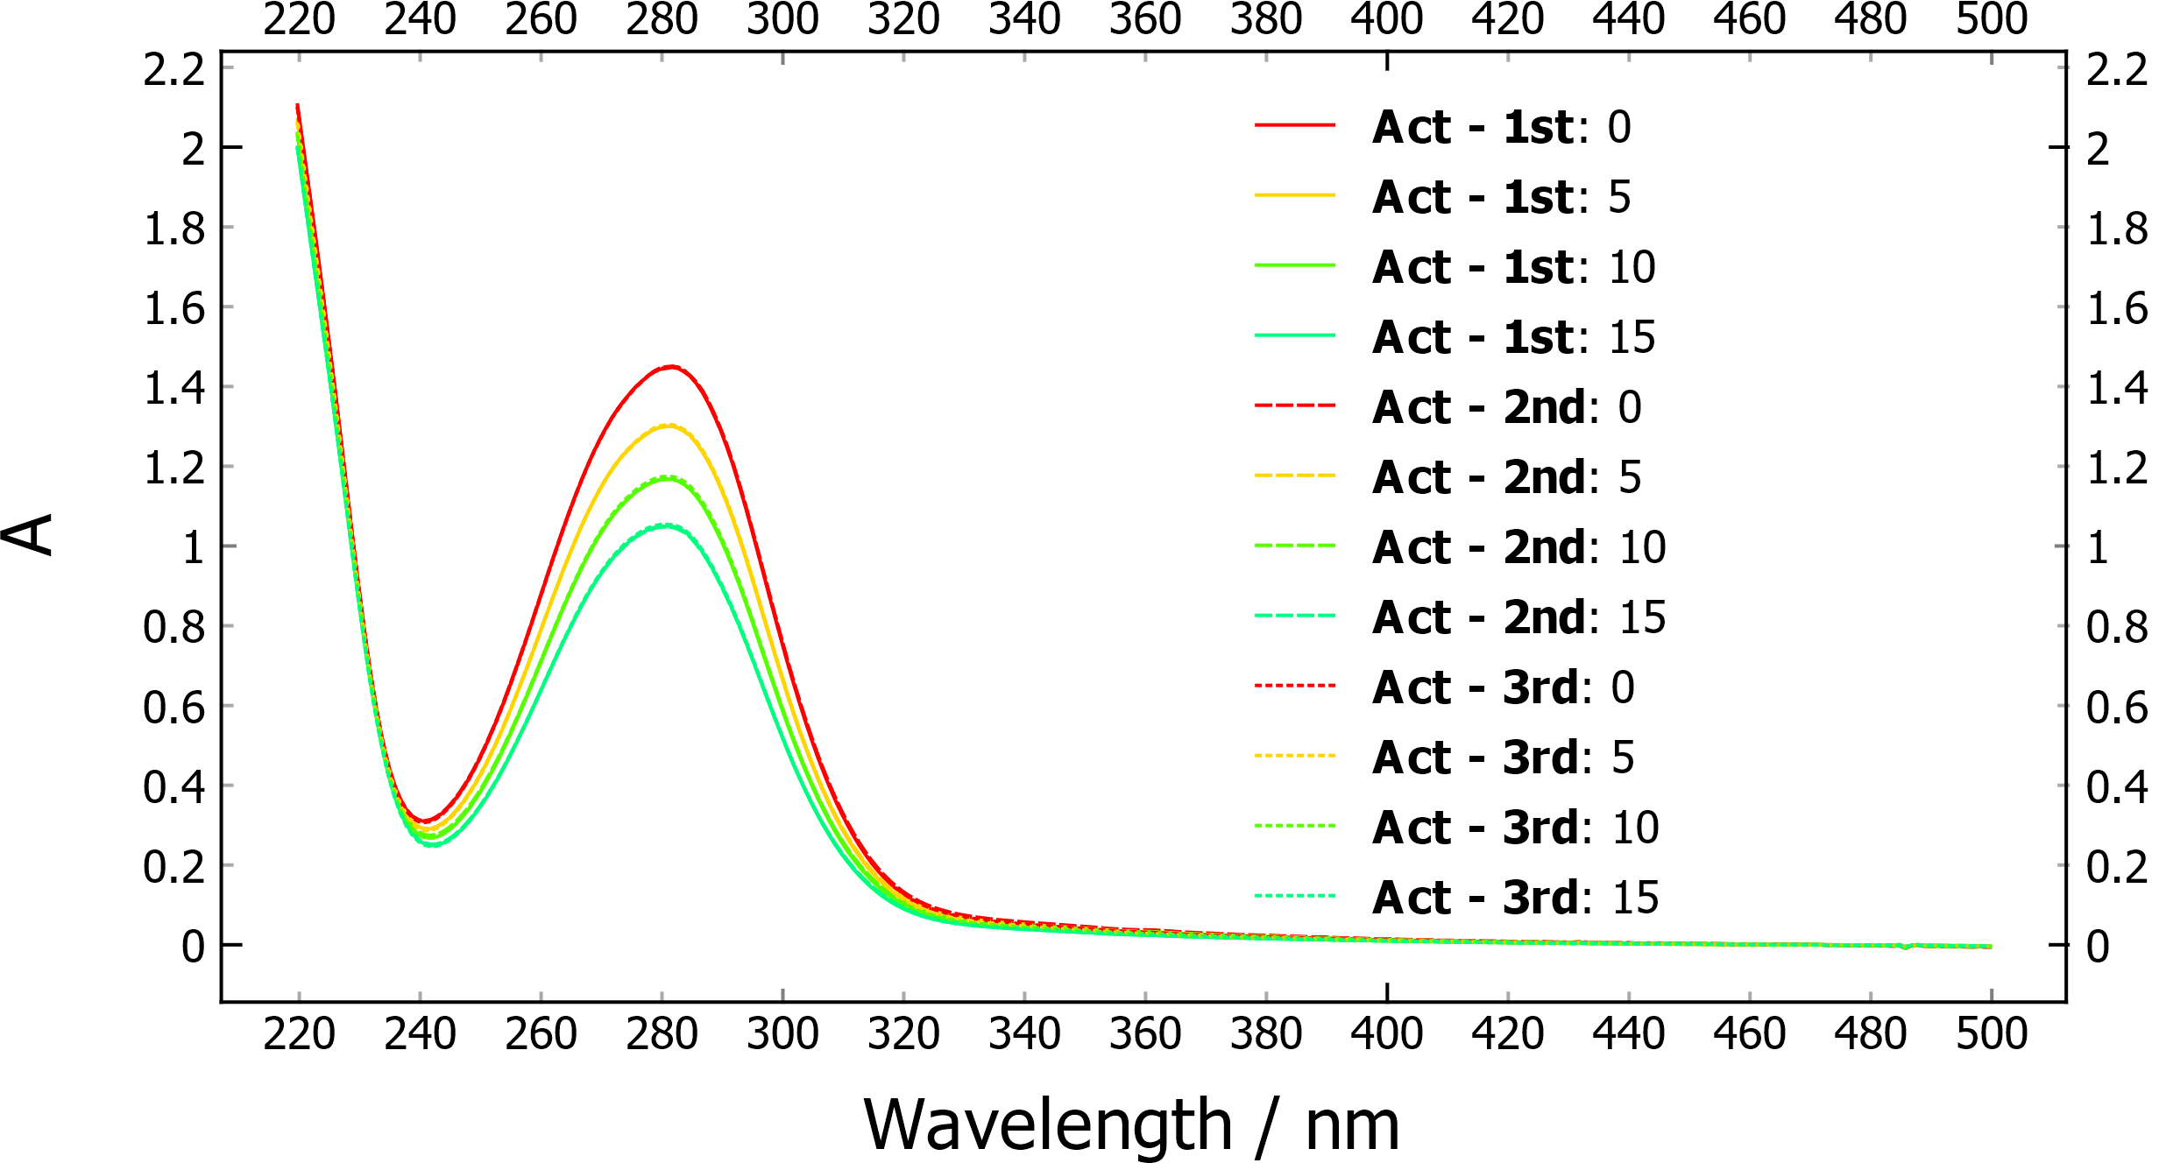
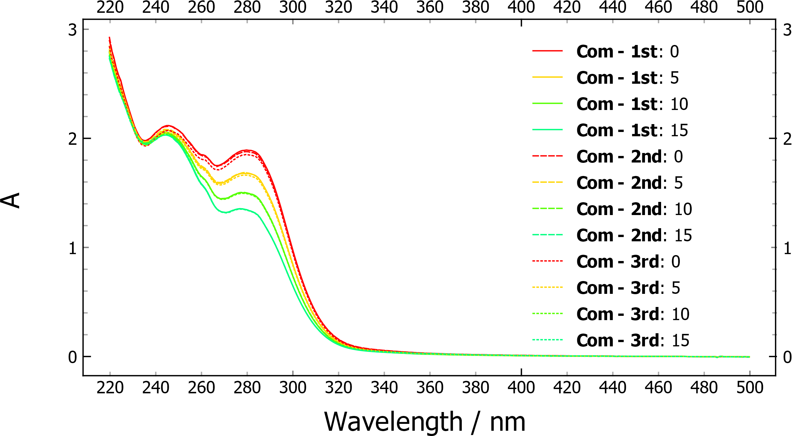
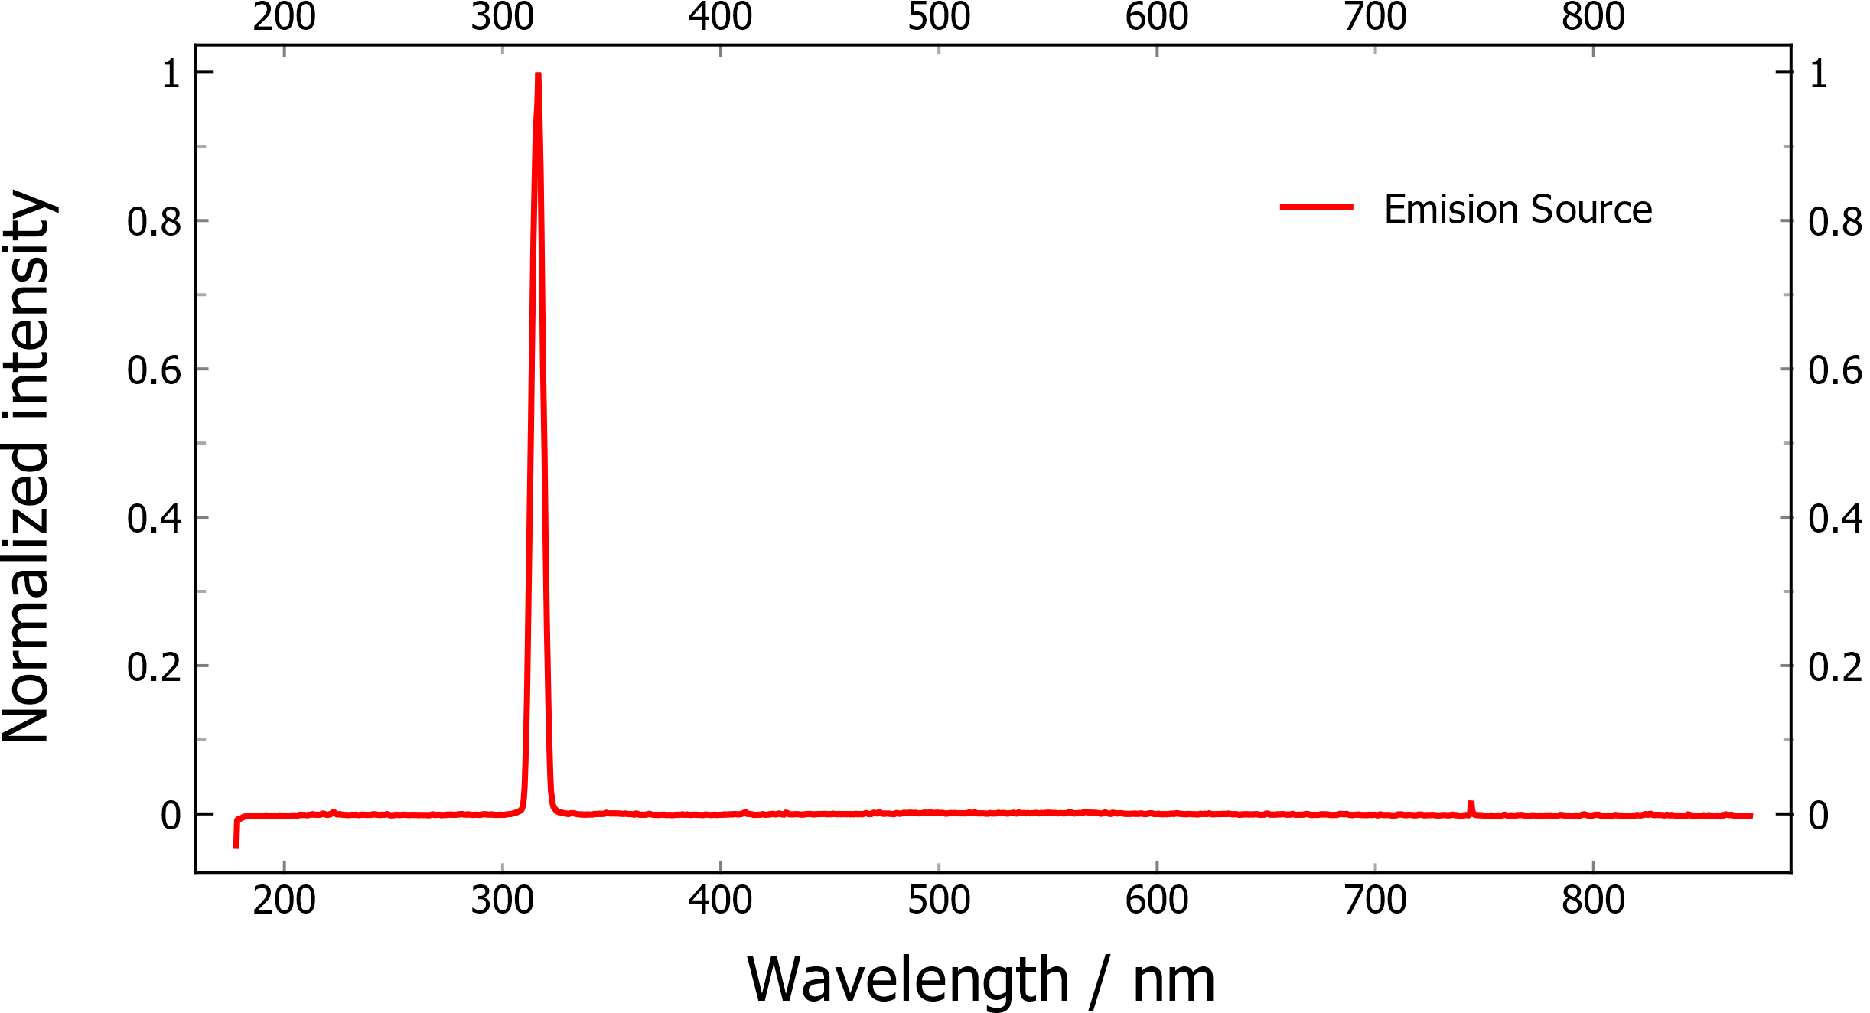
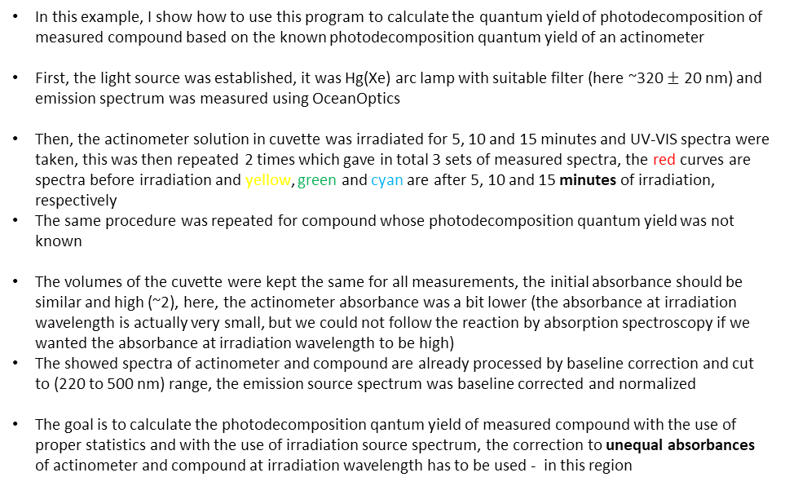
Example: Photodecomposition QY calculation
In this example, I show how to use this program to calculate the quantum yield of photodecomposition of measured compound based on the known photodecomposition quantum yield of an actinometer
First, the light source was established, it was Hg(Xe) arc lamp with suitable filter (here ~320 $±$ 20 nm) and emission spectrum was measured using OceanOptics
Then, the actinometer solution in cuvette was irradiated for 5, 10 and 15 minutes and UV-VIS spectra were taken, this was then repeated 2 times which gave in total 3 sets of measured spectra, the red curves are spectra before irradiation and yellow, green and cyan are after 5, 10 and 15 minutes of irradiation, respectively
The same procedure was repeated for compound whose photodecomposition quantum yield was not known
The volumes of the cuvette were kept the same for all measurements, the initial absorbance should be similar and high (~2), here, the actinometer absorbance was a bit lower (the absorbance at irradiation wavelength is actually very small, but we could not follow the reaction by absorption spectroscopy if we wanted the absorbance at irradiation wavelength to be high)
The showed spectra of actinometer and compound are already processed by baseline correction and cut to (220 to 500 nm) range, the emission source spectrum was baseline corrected and normalized
The goal is to calculate the photodecomposition qantum yield of measured compound with the use of proper statistics and with the use of irradiation source spectrum, the correction to unequal absorbances of actinometer and compound at irradiation wavelength has to be used - in this region
Actinometer (3 sets)
Compound (3 sets)
Irradiation source
absorbing photoproduct

Slide 15
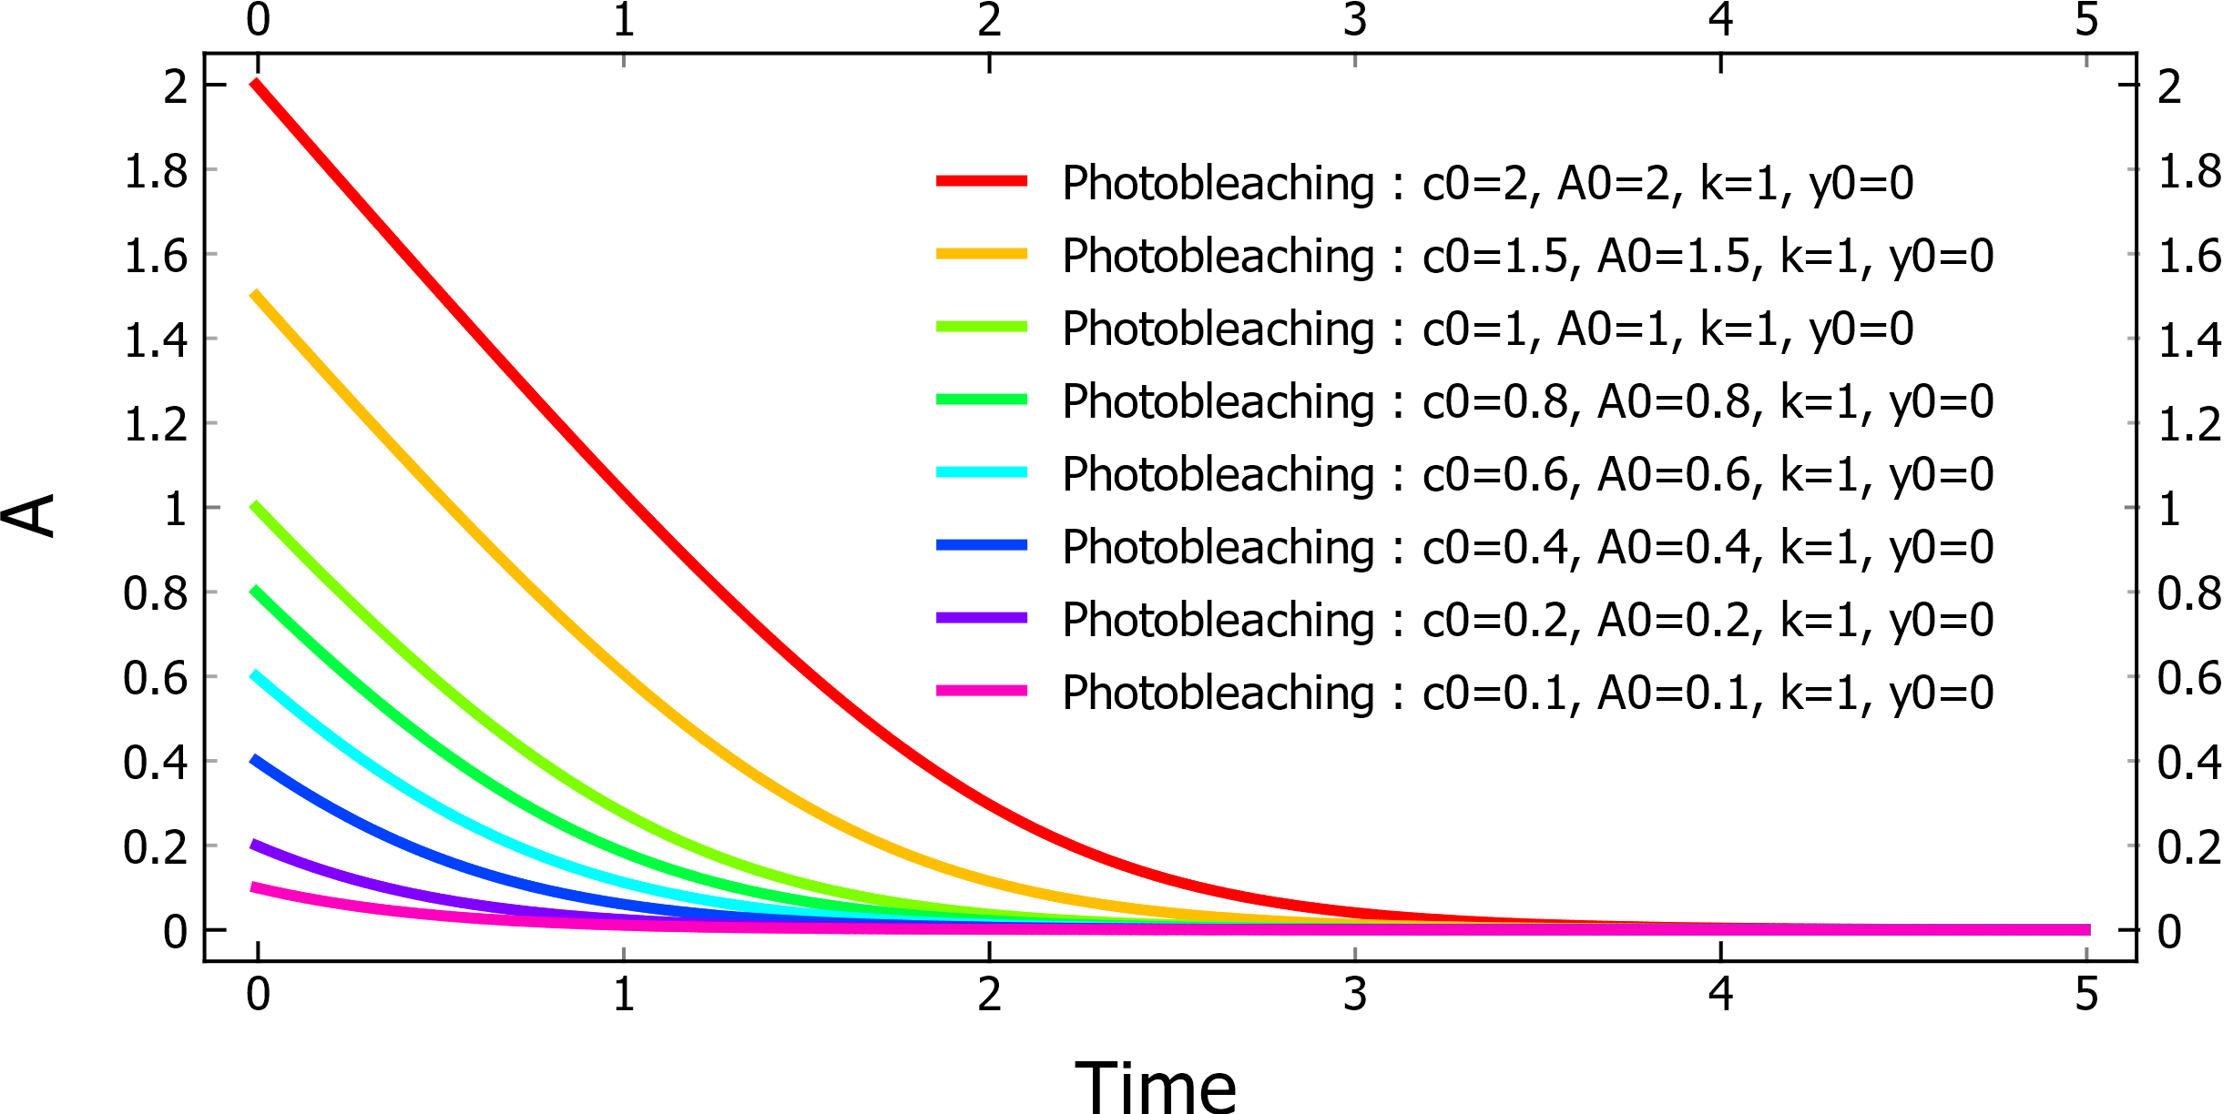
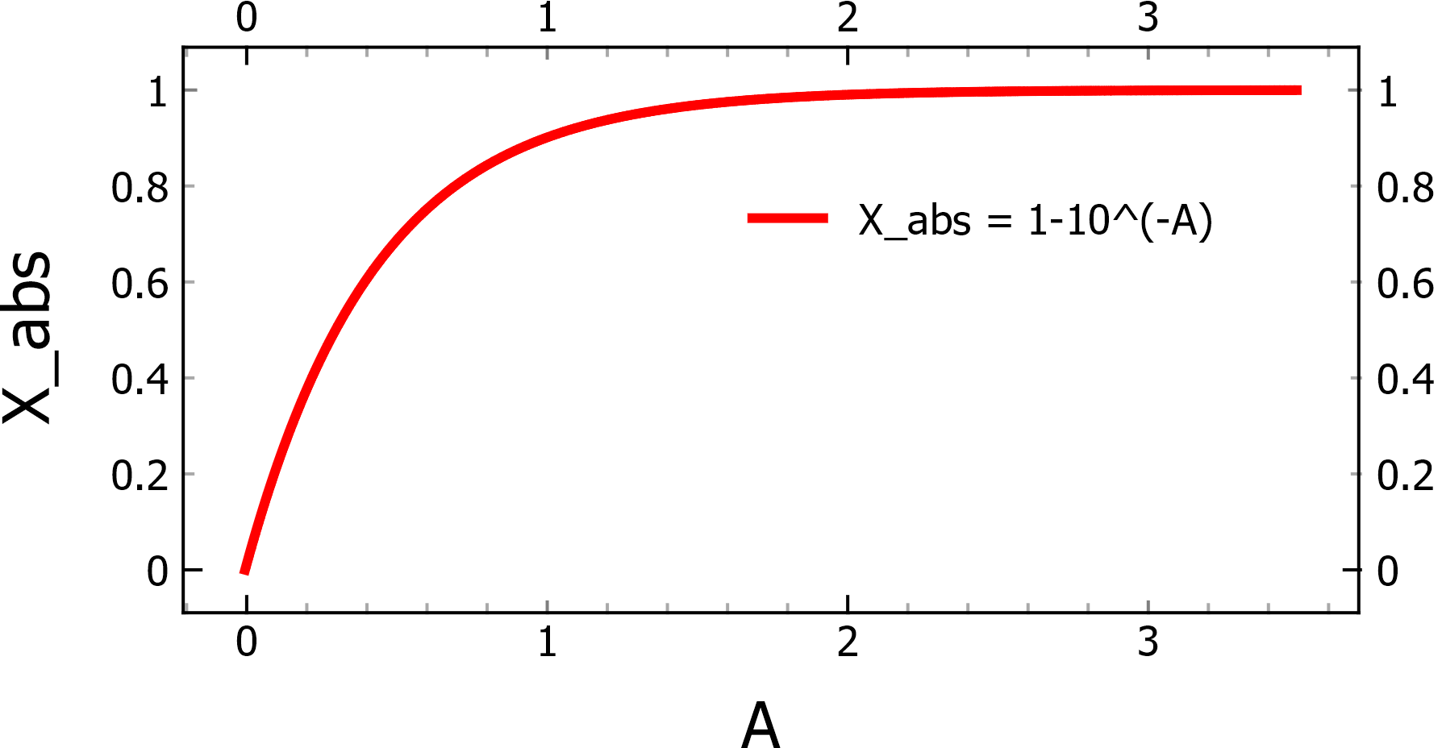
Example: Photodecomposition QY calculation - theory
The decrease of absorbance (concentration of compound) during photoirradiation at constant intensity is proportional to the photodecomposition quantum yield, light intensity and the fraction of the light , that was absorbed by the solution at that time. The differential equation is similar to the photobleaching model (irradiated and plotted wavelength are the same), found in Documentation under the fit models.
irradiation at single wavelength
irradiation with broad emission intensity**
If we would solve the differential equation for the simple case (irradiation at single wavelength, photobleaching model), it is obvious that at higher irradiated initial absorbances (A > 2), the fraction of absorbed light is close to 1 and the value is ‘constant’ with changing of absorbance, as a result, the rate of decrease is almost constant, because all light is absorbed, the result is linear decrease
However, with lower absorbances, the fraction of absorbed light decreases and the rate of decay slows down, which causes changing of the linear decay into first order decay (in the limit that initial absorbance goes to zero)
Dependence of the fraction of absorbed light on the absorbance of the solution
So we can approximate the differential equation by changing the infinitesimal changes to discrete changes
By combining the equations, we get rid of the constant light intensity and volume of the solution, that was kept the same for both actinometer and compound
The quantum yield for actionometer is known, and the only unknown in the equation is now the photodecomposition quantum yield of compound (concentration can be calculated from molar abs. coefficients or from initial concentration, which are known)
actinometer
compound
**The part of absorbed light must be a number in the interval of (0, 1), so it has to be normalized, however, because we actually need to calculate ratio of these fractions for actinometer and measured compound, normalization factor would cancel out, so we don’t have to compute this factor...

Slide 16
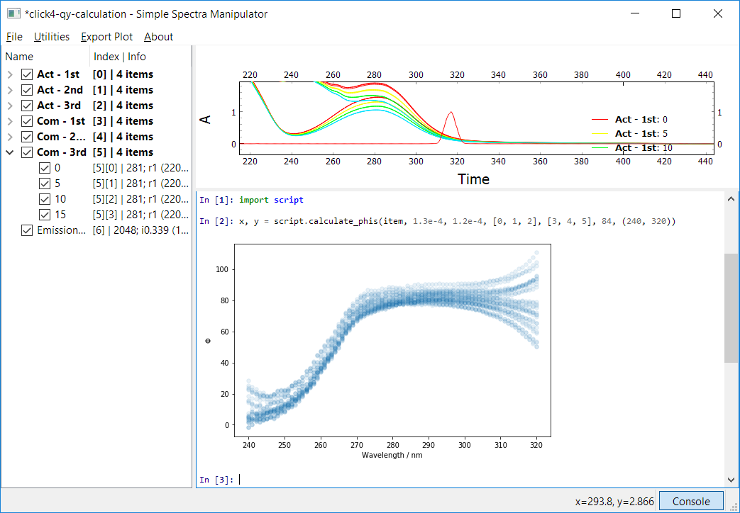
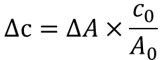
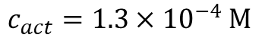
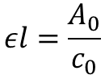
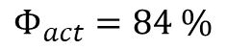
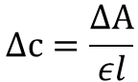
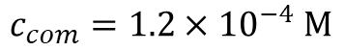
Example: Photodecomposition QY calculation - uncorrected
There is number of ways how to perform the calculation, but we will focus on the easier one, only with the use of closest combinations. It means, that we will combine first difference of actinometer with first difference of the compound, the second difference of actinometer with the second difference of the compound and so on... If we take two sets (each has 4 measurement), we only make calculation 3 times. We will however combine all sets, so that is in total 9 combinations (3x3). So, for one wavelength, we get in total 9x3=27 results. We can perform this calculation for every wavelength and plot the 2D map. Then, we can pick the quantum yields in a range of wavelengths, where it looks linear and perform statistics and error estimation from this range.
Now, we have to write python code that will perform the calculation, lets first try it without correction. The code was written to file cript.py and was placed into folder of SSM.
$$c_{act}=1.3×{10}^{−4} M$$
$$c_{com}=1.2×{10}^{−4} M$$
$$Φ_{act}=84 \%$$
The changes in concentrations are computed from changes in absorbances according to Beer-Lamber law, A₀ is absorbance before irradiation
$$Δc=\frac{ΔA}{εl}$$
$$εl=\frac{A_{0}}{c_{0}}$$
wavelength range
$$Δc=ΔA×\frac{c_{0}}{A_{0}}$$
linear region
Each blue circle represents one quantum yield calculation
Now, we should incorporate the correction to unequal absorbances

Slide 17
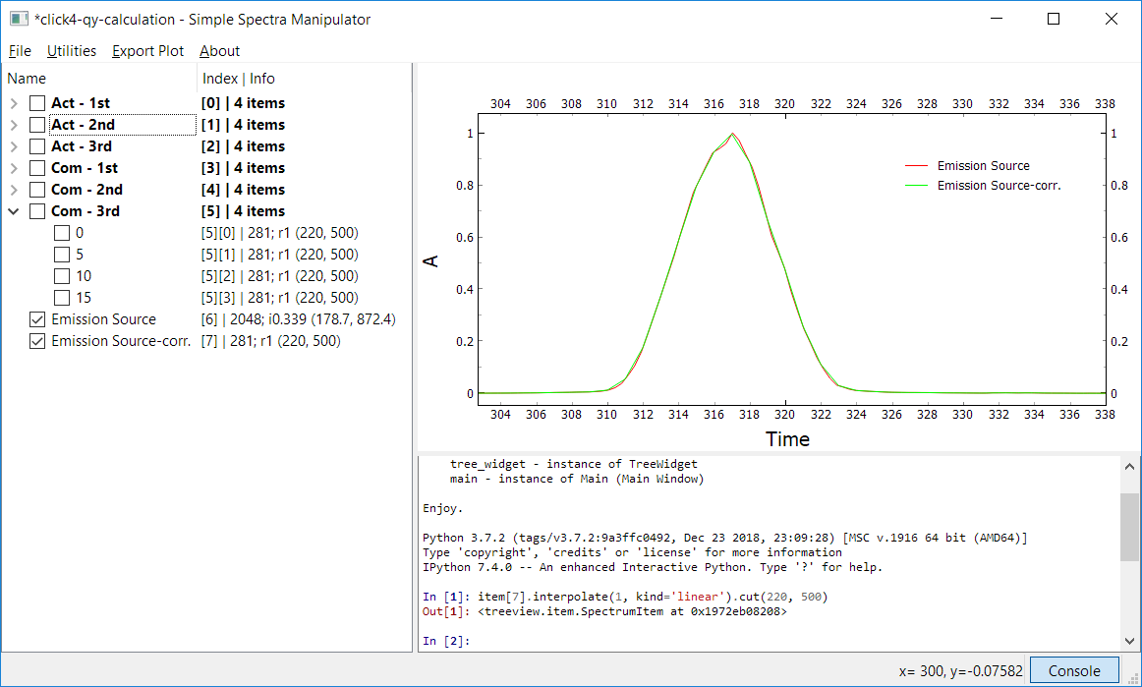
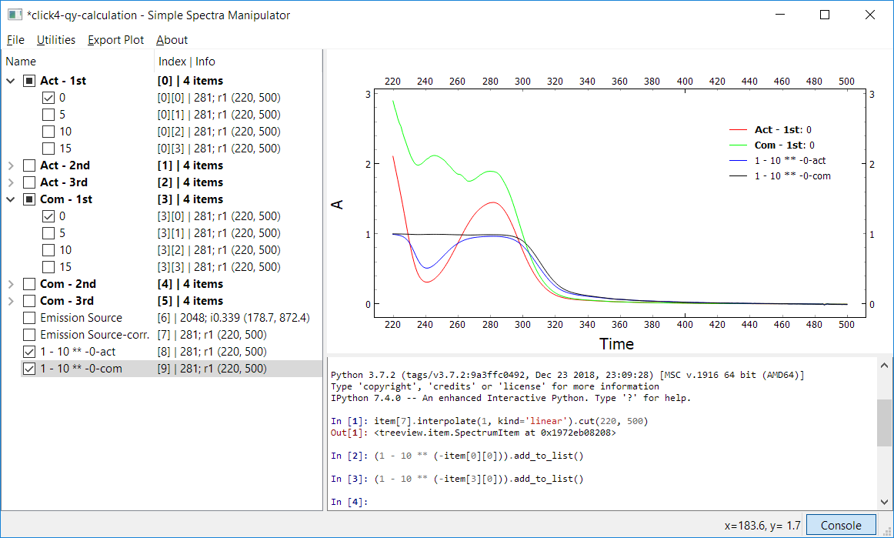
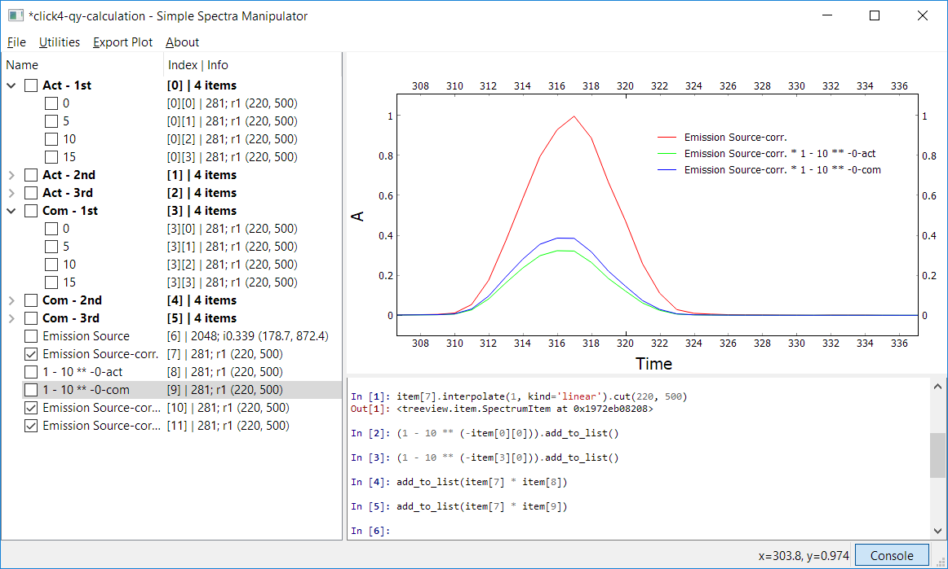

Example: Photodecomposition QY calculation - correction
First, we have to further process the emission source spectrum, because the points are unevenly spaced and the x range does not match with the spectra of actinometer and compound, so we would not be able to calculate any integrals... So we can do it manually, or by just one line of code in the console. I made a copy of the emission spectrum, renamed it and performed the computation. The result i apparent.
Now, we can try to calculate how much light is gonna be absorbed by for example first stock solutions of compond and actinometer, the black and blue spectra are the result after perfoming $1−{10}^{−A}$ transformations for compound and actinometer, respectively
now, it matches
We can then try to calculate the actual light intensity, that would be abosrbed by the solution (blue and green spectra), and we can see, that less than half of the light was absorbed
We can calculate it precisesly by integrating the resulting spectrum and normalizing by normalization factor (integral of emission source)
So, by calling integral() function without any arguments, the whole spectrum is integrated (here from 220 to 500 nm) by trapezoid integration method. The actinometer and compound actually absorbed 33 % and 39 % light from emission source, respectively

Slide 18


Example: Photodecomposition QY calculation - corrected
Now, we can automate this and add this to our script and perform the calculation again, but now with the correction. We can see, that the linear region part was decreased a little bit (from cca 80 to 70). This make sense, because the amount of absorbed light by compound was a bit higher than that of actinometer, so more of it was bleached. If the changes of concentrations are the same, quantum yield of compound photobleching must be lower when compared to that of uncorrected result.
The linar region seems to be around 285 to 295 nm.
Before this region ($λ<270 nm$), there is a formation of photoproduct from the measured compound, therefore, the quantum yield values are lower.
After this region ($λ>300 nm$), both actinometer and spectrum are not absorbing anymore, therefore, very large error is obvious in the the result.
photoproduct formation
emission spectrum
linear region

Slide 19



Example: Photodecomposition QY calculation – statistics on 285-295 nm region
Now, we can pick the linear region, average the values in it and calculate the standard deviation. For that, we crop x and y variables that we got from the calculation. The x variable represent the wavelengths and y value the quantum yields at these wavelengths. Both objects are NumPy 2D arrays (matrices).
So, we can conlude, that the photodecomposition quantum yield is $Φ_{com}=\left(71±2\right)\%$
Also, we can plot histogram from these 297 values to see, whether we can use standard deviation estimation, because it should be used only if the data are normally distributed. Well, it seems more or less OK, but it would be better to have more results for proper estimation.
Stdev is calculated by function np.std() and the result is sigma, so the error is given in the statistical level of one sigma
crop matrices
statistics from 27*11 = 297 values
https://docs.scipy.org/doc/numpy/reference/generated/numpy.std.html
Some comment regarding the script design is needed. Here, the QY values were calculated by using closest combination, however, we could combine the two sets differently, eg. by combining each difference in one set with each difference in other set. We would get more points. Or we could combine all possible differences from one set with all possible differences with other set. If the set would contain 4 spectra, we could choose at max 6 differences. If we combined two sets, we would get 6*6=36 results (instead of 3 as in this simple case).
Also, the correction to unequal absorbances here is only approximation (it is OK if we keep the absorbance changes small), it can be done better, but the code would be much more complicated (some numerical integration should probably be involved)
Possible code modifications are left as an excercise for the reader

Slide 20
Example: Photodecomposition QY calculation
Source code from script.py
def calculate_set(act_set, com_set, c_0_act, c_0_com, phi_act, wl=285, em_source=None):
# assuming that the number spectra in actinometer and compound set is the same
# thus, len(act_set) == len(com_set), ** both act_set and com_set are instances of SpectrumList!
# number of items in set
length = len(act_set)
# find index in data array of actinometer and compound that corresponds to the choosed wavelength
idx_act = Spectrum.find_nearest_idx(act_set[0].data[:, 0], wl)
idx_com = Spectrum.find_nearest_idx(com_set[0].data[:, 0], wl)
# set absorbances at time zero for both actinometer and compound at wavelength wl
A0_act = act_set[0].data[idx_act, 1]
A0_com = com_set[0].data[idx_com, 1]
# calculate the ratio of c0 and A0 for actinometer and compound
c0A0_act = c_0_act / A0_act
c0A0_com = c_0_com / A0_com
# define list of computed quantum yields
phis = []
for i in range(1, length):
# calculate change of absorbance between two measurements for act and com
dA_act = act_set[i - 1].data[idx_act, 1] - act_set[i].data[idx_act, 1]
dA_com = com_set[i - 1].data[idx_com, 1] - com_set[i].data[idx_com, 1]
# calculate corresponding change in concentrations
dc_act = c0A0_act * dA_act
dc_com = c0A0_com * dA_com
# calculate the changes in times, use the value in name of the spectrum
dt_act = float(act_set[i - 1].name) - float(act_set[i].name)
dt_com = float(com_set[i - 1].name) - float(com_set[i].name)
# calculate the quantum yield
phi_com = phi_act * dc_com * dt_act / (dc_act * dt_com)
# if user provided emission source, calculate the correction
if em_source is not None:
# calculate the absorbed light intensity (we use absorption spectrum
# at the begining of the interval - i-1
abs_int_act = em_source * (1 - 10 ** (-act_set[i - 1]))
abs_int_com = em_source * (1 - 10 ** (-com_set[i - 1]))
# integrate those spectra
x_abs_act = abs_int_act.integral()
x_abs_com = abs_int_com.integral()
# apply the correction
phi_com *= x_abs_act / x_abs_com
# add the result to the list
phis.append(phi_com)
return phis
Presented code is definetly not perfect and could be optimized in many ways, it is, however, sufficient for demonstration purposes
import numpy as np
import matplotlib.pyplot as plt
from spectrum import Spectrum
def calculate_phis(item, c_0_act, c_0_com, act_idxs, com_idxs, phi_act, wl_range=(240, 330), em_source=None):
sp = item[act_idxs[0]][0]
idx_0 = Spectrum.find_nearest_idx(sp.data[:, 0], wl_range[0])
idx_1 = Spectrum.find_nearest_idx(sp.data[:, 0], wl_range[1]) + 1
# hardcoded number of solutions, this is not general, for other use, please change this number or rewrite the code
solutions = 27
wls = idx_1 - idx_0 # number of wavelengths
wls_mat = np.tile(sp.data[idx_0:idx_1, 0], (solutions, 1)) # define matrix of wavelengths (x values for plotting)
matrix = np.zeros((solutions, wls)) # define matrix of results, dimensions: 27 x [number of wavelengths]
# for each wavelength in defined range
for i in range(wls):
# get the current wavelength
wl = sp.data[idx_0 + i, 0]
# calculate the 27 values at this wavelength
phis = calculate_phi(item, c_0_act, c_0_com, act_idxs, com_idxs, phi_act, wl=wl, em_source=em_source)
# fill the i-th column of the matrix with the solution
matrix[:, i] = np.asarray(phis)
# plot the matrix, parameter s is size of the circle, alpha sets transparency
plt.rcParams['figure.figsize'] = [8, 5]
plt.scatter(wls_mat, matrix, s=30, alpha=0.1)
plt.ylabel('$\Phi$')
plt.xlabel('Wavelength / nm')
plt.show()
return wls_mat, matrix
def calculate_phi(item, c_0_act, c_0_com, act_idxs, com_idxs, phi_act, wl=285, em_source=None):
# define list of results
phis = []
# for every actinometer set
for act in act_idxs:
# for every compound set
for com in com_idxs:
# perform calculation between current sets and add the results into list
phis += calculate_set(item[act], item[com], c_0_act, c_0_com, phi_act, wl, em_source)
return phis
QY calculation
correction

